Slide 1
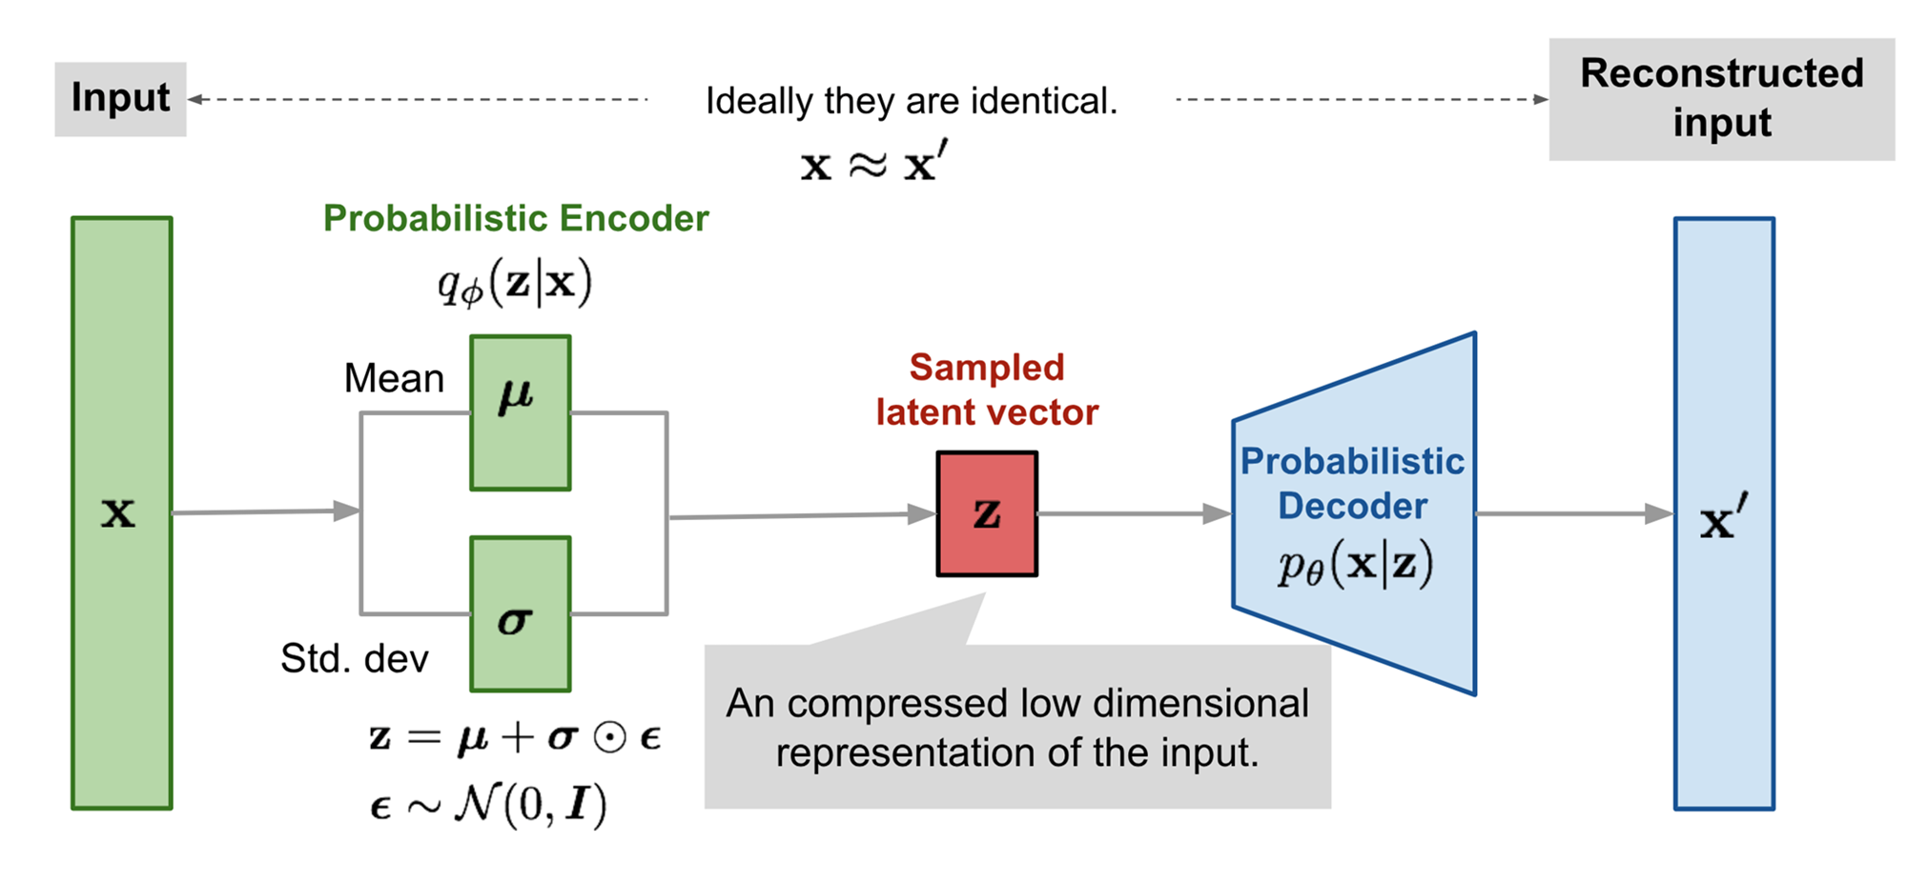
VAE Motivation
Instead of mapping the input into a fixed vector, we want to map it into a distribution.
Blog to read: Variational autoencoders.
Tutorial - What is a variational autoencoder? – Jaan Altosaar

Slide 2
We will now look at variational autoencoders which have the same structure as autoencoders but they learn a distribution over the hidden variables
CS7015 (Deep Learning) : Lecture 21

Slide 3
Variational Autoencoders: The Neural Network Perspective
CS7015 (Deep Learning) : Lecture 21

Slide 4
VAE - Goal
The goal of VAE is to find a distribution Qθ (z|x ) of some latent varaibles , which we can sample from Z ~ Q_{φ}(z|x), to generate new sampes x` from P_{φ}(x|z)
Q_{φ} (Z/X)
P _{θ} (Z/X)
X
X`
Z

Slide 5
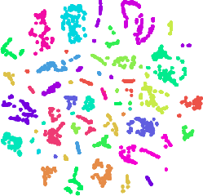
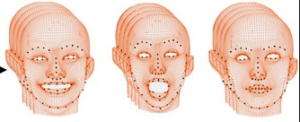
Let {X = x_{i}}^{N} be the training data
i=1
We can think of X as a random variable in R^{n}
For example, X could be an image and the dimensions of X correspond to pixels of the image
We are interested in learning an abstraction (i.e., given an X find the hidden representa- tion z)
We are also interested in generation (i.e., given a hidden representation generate an X)
In probabilistic terms we are interested in P (z|X) and P (X|z) (to be consistent with the literation on VAEs we will use z instead of H and X instead of V )
Figure: Abstraction
Figure: Generation
11/36
CS7015 (Deep Learning) : Lecture 21

Slide 6
We now return to our goals
Goal 1: Learn a distribution over the latent variables (Q(z|X))
Goal 2: Learn a distribution over the visible variables (P (X|z))
VAEs use a neural network based encoder for Goal 1
and a neural network based decoder for Goal 2
We will look at the encoder first
Reconstruction: X^{ˆ}
Decoder P_{φ}(X|z)
z
Encoder Q_{θ} (z|X)
Data: X
θ: the parameters of the encoder
neural network
φ: the parameters of the decoder
neural network
13/36
CS7015 (Deep Learning) : Lecture 21

Slide 7








z
Encoder: What do we mean when we say we want to learn a distribution? We mean that we want to learn the parameters of the distribution
But what are the parameters of Q(z|X)? Well it depends on our modeling assump- tion!
Q_{θ} (z|X)
X
14/36
CS7015 (Deep Learning) : Lecture 21

Slide 8








Encoder: What do we mean when we say we want to learn a distribution? We mean that we want to learn the parameters of the distribution
z
µ
Σ
But what are the parameters of Q(z|X)?
_{Q (z|X)} Well it depends on our modeling assump-
θ
tion!
In VAEs we assume that the latent variables come from a standard normal distribution N (0, I) and the job of the encoder is to then predict the parameters of this distribution
X
X ∈ R^{n}, µ ∈ R^{m} and Σ ∈ R^{m×m}
14/36
CS7015 (Deep Learning) : Lecture 21

Slide 9












Now what about the decoder?
_{X}ˆ _{i}
P_{φ}(X|z)
The job of the decoder is to predict a probab- ility distribution over X : P (X|z)
Once again we will assume a certain form for this distribution
For example, if we want to predict 28 x 28 pixels and each pixel belongs to R (i.e., X ∈ R⁷⁸⁴) then what would be a suitable family for P (X|z)?
We could assume that P (X|z) is a Gaussian distribution with unit variance
The job of the decoder f would then be to predict the mean of this distribution as f_{φ}(z)
z
Sample
µ
Σ
Q_{θ} (z|X)
X_{i}
15/36
CS7015 (Deep Learning) : Lecture 21

Slide 10
What would be the objective function of the decoder ?
_{X}ˆ _{i}
P_{φ}(X|z)
For any given training sample x_{i} it should maximize P (x_{i}) given by
ˆ
z
Sample
P (x_{i}) = P (z)P (x_{i}|z)dz
= −E_{z∼Qθ (z|xi)}[log P_{φ}(x_{i}|z)]
(As usual we take log for numerical stability)
µ
Σ
Q_{θ} (z|X)
X_{i}
16/36
CS7015 (Deep Learning) : Lecture 21

Slide 11
This is the loss function for one data point (l_{i}(θ)) and we will just sum over all the data points to get the total loss L (θ)
_{X}ˆ _{i}
P_{φ}(X|z)
m
Σ
L (θ) = l (θ)
i
z
i=1
Sample
In addition, we also want a constraint on the distribution over the latent variables
Specifically, we had assumed P (z) to be N (0, I) and we want Q(z|X) to be as close to P (z) as possible
µ
Σ
Q_{θ} (z|X)
X_{i}
17/36
CS7015 (Deep Learning) : Lecture 21

Slide 12
This is the loss function for one data point (l_{i}(θ)) and we will just sum over all the data points to get the total loss L (θ)
_{X}ˆ _{i}
P_{φ}(X|z)
m
Σ
L (θ) = l (θ)
i
z
i=1
Sample
In addition, we also want a constraint on the distribution over the latent variables
Specifically, we had assumed P (z) to be N (0, I) and we want Q(z|X) to be as close to P (z) as possible
Thus, we will modify the loss function such that
µ
Σ
Q_{θ} (z|X)
X_{i}
l_{i}(θ, φ) = −E_{z∼Qθ (z|xi)}[log P_{φ}(x_{i}|z)]
+KL(Q_{θ} (z|x_{i})||P (z))
17/36
CS7015 (Deep Learning) : Lecture 21

Slide 13
This is the loss function for one data point (l_{i}(θ)) and we will just sum over all the data points to get the total loss L (θ)
_{X}ˆ _{i}
P_{φ}(X|z)
m
Σ
L (θ) = l (θ)
i
z
i=1
Sample
In addition, we also want a constraint on the distribution over the latent variables
Specifically, we had assumed P (z) to be N (0, I) and we want Q(z|X) to be as close to P (z) as possible
Thus, we will modify the loss function such that
µ
Σ
Q_{θ} (z|X)
X_{i}
KL divergence captures
the difference (or distance)
l_{i}(θ, φ) = −E_{z∼Qθ (z|xi)}[log P_{φ}(x_{i}|z)]
between 2 distributions
+KL(Q_{θ} (z|x_{i})||P (z))
17/36
CS7015 (Deep Learning) : Lecture 21

Slide 14
The second term in the loss function can actually be
_{X}ˆ _{i}
thought of as a regularizer
It ensures that the encoder does not cheat by mapping ^{each x}i to a different point (a normal distribution with very low variance) in the Euclidean space
In other words, in the absence of the regularizer the encoder can learn a unique mapping for each xi ^{and} the decoder can then decode from this unique mapping
Even with high variance in samples from the distribu- tion, we want the decoder to be able to reconstruct the original data very well (motivation similar to the adding noise)
P_{φ}(X|z)
z
Sample
µ
Σ
Q_{θ} (z|X)
X_{i}
l_{i}(θ, φ) = −E_{z∼Qθ (z|xi)}[log P_{φ}(x_{i}|z)]
+KL(Q_{θ} (z|x_{i})||P (z))
18/36
CS7015 (Deep Learning) : Lecture 21

Slide 15
The second term in the loss function can actually be
_{X}ˆ _{i}
thought of as a regularizer
It ensures that the encoder does not cheat by mapping ^{each x}i to a different point (a normal distribution with very low variance) in the Euclidean space
In other words, in the absence of the regularizer the encoder can learn a unique mapping for each xi ^{and} the decoder can then decode from this unique mapping
Even with high variance in samples from the distribu- tion, we want the decoder to be able to reconstruct the original data very well (motivation similar to the adding noise)
To summarize, for each data point we predict a distri- bution such that, with high probability a sample from this distribution should be able to reconstruct the ori- ginal data point
P_{φ}(X|z)
z
Sample
µ
Σ
Q_{θ} (z|X)
X_{i}
l_{i}(θ, φ) = −E_{z∼Qθ (z|xi)}[log P_{φ}(x_{i}|z)]
+KL(Q_{θ} (z|x_{i})||P (z))
18/36
CS7015 (Deep Learning) : Lecture 21

Slide 16
Module 21.3: Variational autoencoders: (The graphical model perspective)
CS7015 (Deep Learning) : Lecture 21

Slide 17

Now at inference time, we are given an X (observed variable) and we are interested in finding the most likely assignments of latent variables z which would have resulted in this observation
z
Mathematically, we want to find
X
_{P (z|X) =} P (X|z)P (z)
N
P (X)
This is hard to compute because the LHS contains
P (X) which is intractable require exponential time to compute
ˆ
The inference problem is to compute the conditional
Distribution of latent variables given observations
P (X) = P (X|z)P (z)dz
^{= ˆ ˆ ... ˆ P (X|z}1^{, z}2^{, ..., z}n^{)P (z}1^{, z}2^{, ..., z}n^{)dz}1^{, ...dz}n
The alternative is to approximate p(z/x) by another
distribution q(z/x) which have tractable solutions.
This is a inference problem solved as an
optimaztaion problem
Modelling p(z/x) using Q(z/x) where
q(z/x) has a simple Gaussian distribution
23/36

Slide 18
Here we can think of z and X as random vari- ables
We are then interested in the joint prob- ability distribution P (X, z) which factorizes as P (X, z) = P (z)P (X|z)
This factorization is natural because we can imagine that the latent variables are fixed first and then the visible variables are drawn based on the latent variables
For example, if we want to draw a digit we could first fix the latent variables: the digit, size, angle, thickness, position and so on and then draw a digit which corresponds to these latent variables
z
X
N
22/36
CS7015 (Deep Learning) : Lecture 21

Slide 19
Specifically, in VAEs, we assume that instead of P (z|X) which is intractable, the posterior distribution is given by Q_{θ} (z|X)
Further, we assume that Q_{θ} (z|X) is a Gaus- sian whose parameters are determined by a neural network µ, Σ = g_{θ} (X)
The parameters of the distribution are thus determined by the parameters θ of a neural network
Our job then is to learn the parameters of this neural network
z
X
N
24/36
CS7015 (Deep Learning) : Lecture 21

Slide 20
But what is the objective function for this neural network
Well we want the proposed distribution Q_{θ} (z|X) to be as close to the true distribu- tion
We can capture this using the following ob- jective function
z
X
N
minimize KL(Q_{θ} (z|X)||P (z|X))
What are the parameters of the objective function ? (they are the parameters of the neural network - we will return back to this again)
25/36
CS7015 (Deep Learning) : Lecture 21

Slide 21
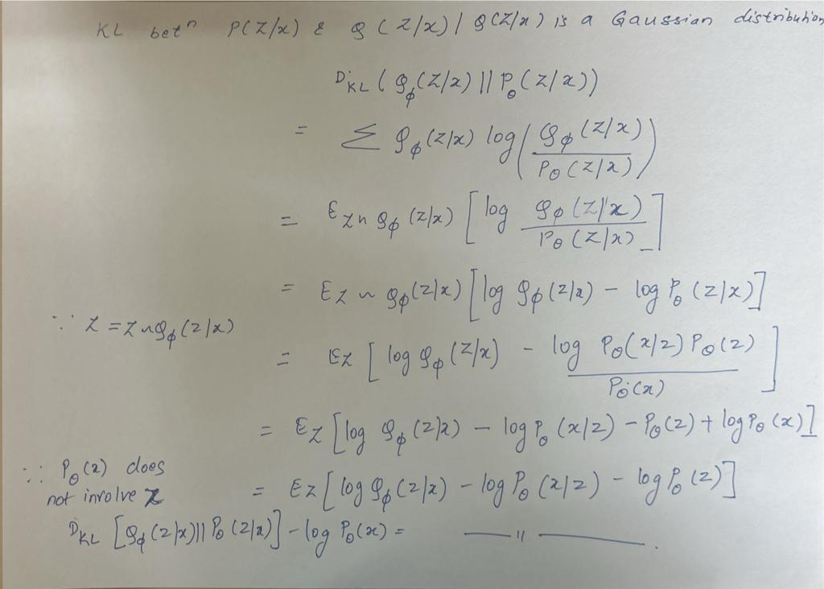

Slide 22
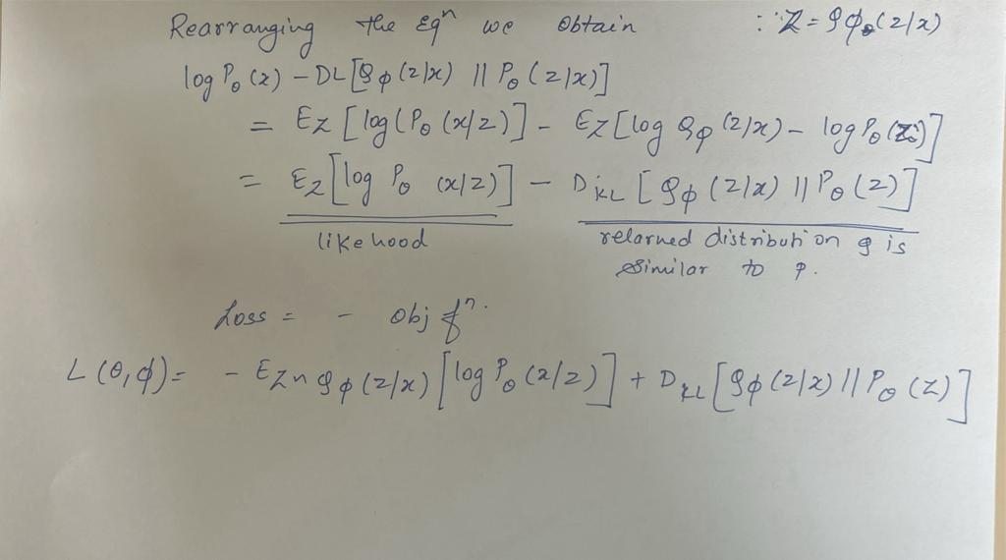

Slide 23
Loss Function of VAE
Li​(θ,ϕ)=−Ez∼qθ​(z∣xi​)​[logpϕ​(xi​∣z)]+KL(qθ​(z∣xi​)∣∣p(z))
Loss = Reconstruction loss + Regularization
Without Reconstruction loss: Learned distribution deviate form the prior
Without Regularization :Network cheat by learning narrow distribution With small variance this distribution is effectively representing single value
With both term in loss function :
the two distribution will be attracted due to first term i.e. Reconstruction loss
Sufficient variance is ensured using KL Divergence .

Slide 24
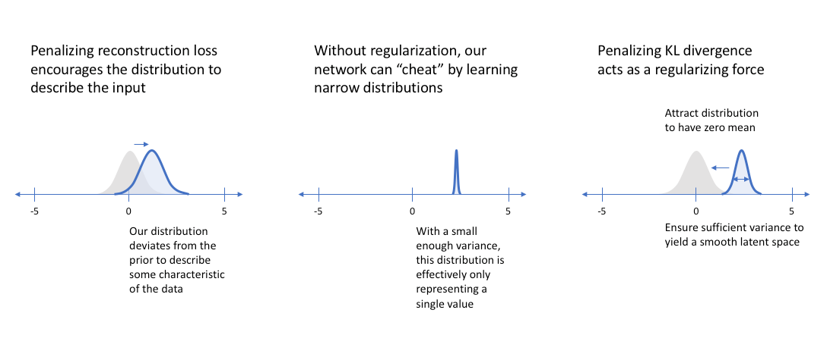
Loss function understanding

